Slide 1
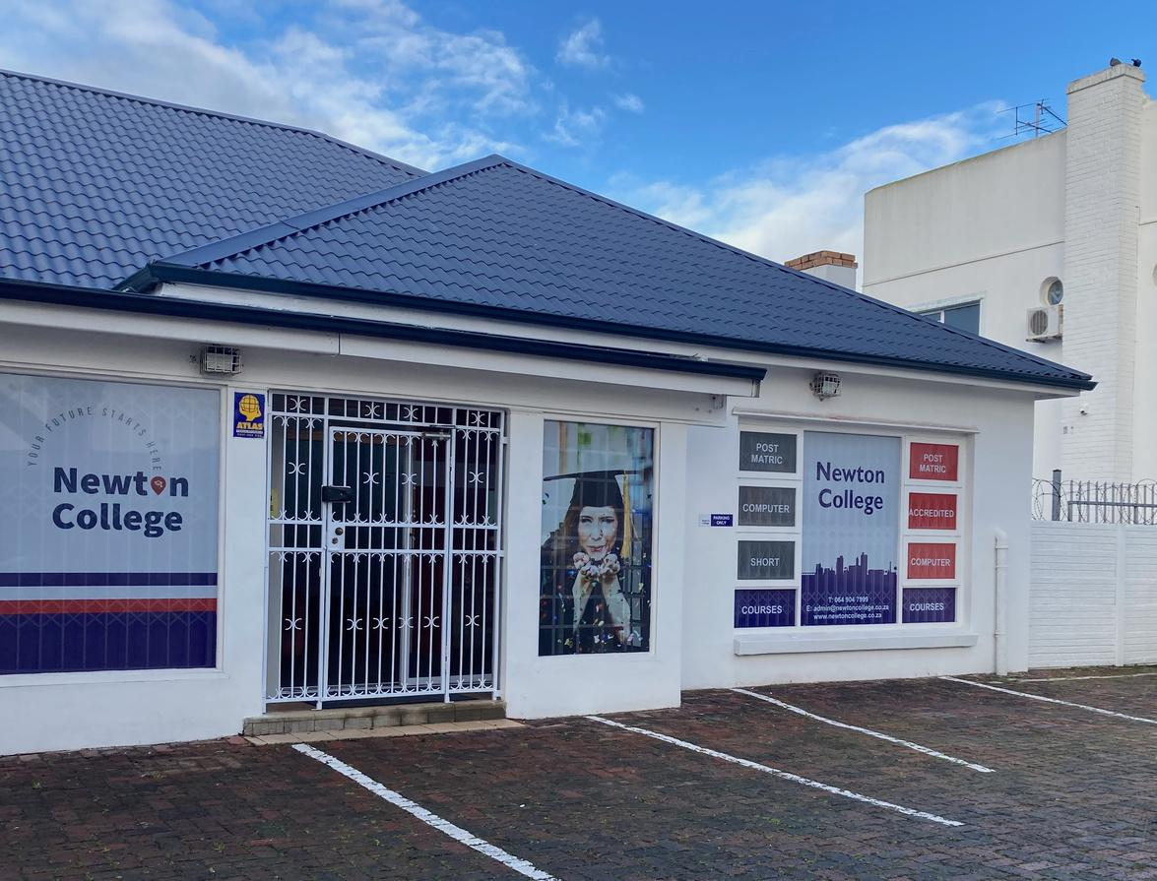




2025
PROSPECTUS
Your future starts here

Slide 2
About us
Agenda
1
  Vision and Mission
  2
  3
  Accreditations and qualifications
  Modes of Learning
  4
  Admission requirements
  5

Slide 3
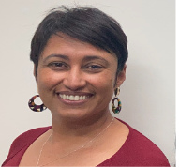
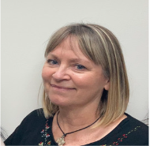

ABOUT US
Newton College was founded in 2017 with our headquarters based in Port Elizabeth, South Africa.
Newton College was, primarily, an educational facility that offered tuition to individuals wanting to achieve their Grade 12 matriculation certificate. We have since diversified our portfolio of offerings to include post matric skills programmes.
We are accredited with the MICT SETA and merSETA for the training and assessment of our skills programs
Understanding the challenges faced by individuals in this current socio-economic climate, Newton College is actively working on financial assistance schemes for individuals to write or rewrite their matric. These efforts are as a result of funding projects initiated by Newton College Foundation or through the CSR program at Newton College.
Charmelle Hiles
Director of Operations
Leigh Armstrong
CEO and Director of ICTs

Slide 4


Our Vision
Be the first choice as an institution for further training and education, built on a commitment to excellence, innovative teaching methods and collaborative partnerships with businesses.
Cultivating learners that will shape the future through strong leadership, resilience and integrity.
Our Mission
Our institution understands that learning is continuous because change is inevitable. We aim to equip learners with the necessary knowledge and skills to become active contributors to the ever-changing demands of the world.
Our environment of learning and development is built on a number of key elements:
  effective communication and collaboration,
  flexibility,
  respect and inclusivity and
  Continuous improvement

Slide 5




Accreditations and qualifications
Skills programs
Skills programs
  Supervisory Management Phase 1
  Supervisory Management Phase 2
  Leadership and problem solving
  Computer systems Operator
  Computer Skills Training - Phase 1
  Computer Skills Training Phase 2

Slide 6
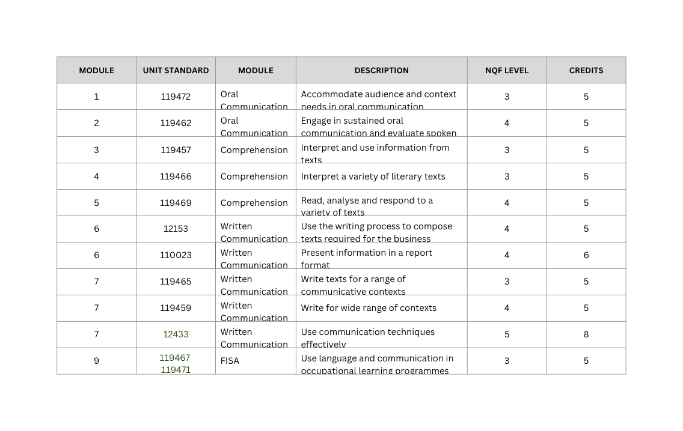
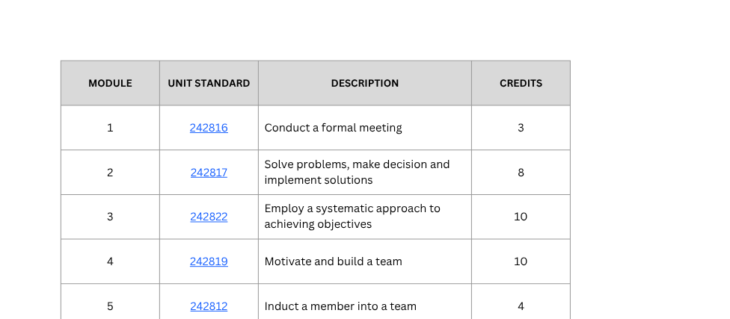
Supervisory Management Phase 1
Supervisory Management Phase 2
NQF Level 4
NQF Level 4

Slide 7
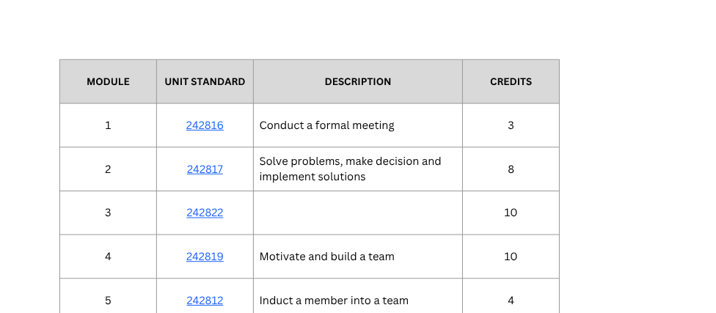
CAT Skills Phase 1
CAT Skills Phase 2
NQF Level 4
NQF Level 4

Slide 8
Short courses
  Introduction to computers
  Basic /intermediate Word
  Basic/ intermediate Excel
  Basic /intermediate Powerpoint
  Advanced excel functions
  How to conduct a formal meeting
  Problem-solving
  Team Dynamics
  Setting departmental objectives
  Departmental induction

Slide 9
Modes of Learning
Skills Programs and Short Courses
Through collaboration with our partners and clients, training for our skills programs can be done in any of the following methods:
  On site training
  Campus training
  Online training
We strive to meet the needs of our clients by offering the most flexible and collaborative approach to the delivery methods of our learning programmes

Slide 10

Second Chance Matric Programme
National Senior Certificate (NSC)
Amended Senior Certificate (ASC)
Qualifying Criteria:
  completed Grade 12 but need to rewrite to improve subject marks.
  Anyone who wrote matric from 2008 onwards
Qualifying Criteria:
  Adult learners who are 21 years
  Minimum of a grade 9 report or an ABET L4
  Or candidates who would want to add a subject to their matric ,candidates possession of a NSC certificate prior to 2008

Slide 11

Modes of Learning- Second Chance Matric
Campus
Blended -
Learning
  Contact lessons available for the following subjects: English HL, Maths LIteracy, Life Science
  Lesson times from 12pm - 4:14pm, Monday to Friday
  3 x 1hr lessons per week per subject
  Progress tests and examinations throughout the year for the student to check their progress..
Self -Study
  The student has access to video recordings of class lessons plus one on one contact lessons (as included in the student package).
  Mid-year and trial examinations available to the student to check progress.
  Students can choose how many contact sessions they require per subject.
  Access to video recordings of class lessons
  One on one contact lessons to be arranged if the student feels he/she needs an intervention.
  Mid-year and trial examinations available to the student to check progress.
Modes of Learning

Slide 12
Modes of Learning-
Skills Programs
Campus
On-Site (Client)
  Contact lessons with an experienced facilitator
  Lesson times will be from 08:30 - 3:30
  Various learning techniques will be utilised dependant on the levels of the candidates
  All work will be on the Learner management system (Google Classroom)
  Learners will have to complete the following assessments:
    Formative
    Knowledge summatives
    Practical summatives.
  Contact lessons with an experienced facilitator atthe client site
  Lesson times will be from 08:30 - 3:30
  All work will be on the Learner management system (Google Classroom)
  Learners will have to complete the following assessments:
    Formative
    Knowledge summatives
    Practical summatives.
On-line
  Access to video recordings of lessons
  All work will be on the Learner management system (Google Classroom)
  Learners will have to complete the following assessments:
  Formative
  Knowledge summatives
  Practical summatives.
Modes of Learning

Slide 13
2025
INITIATIVES
Your future starts here

Slide 14


Our Vision
Build relationships that are sustainable, resilient and have long term tenures with both businesses and governmental institutions. Secure funding and sponsorships that will enable more learners to become active participants in our economy
Our Pledge
Newton College has pledged that for every 15th fee paying student we will sponsor a student with a subsidy of up to 80% scholorship to enable them to rewrite their national senior certificate examinations . Maximum of two subjects per year

Slide 15



Sponsorship Initiatives
Reach One Teach One Programme
Working with local NOP’s, candidates are identified and then put through one of our skills programs. Recipients are equipped with skills to assist them with workplace readiness and also provide them with opportunities to become more employable
Second Chance Matric Programme
A 2017 study showed that 48% of children who start school do not complete grade 12 and the pandemic has only exacerbated this social problem. South Africa faces a growing pool of adults that do not have the basic minimum grade 12 school leaving certificate.
Your sponsorship will enable candidates in studying towards them achieving their Matric Certificate

Slide 16
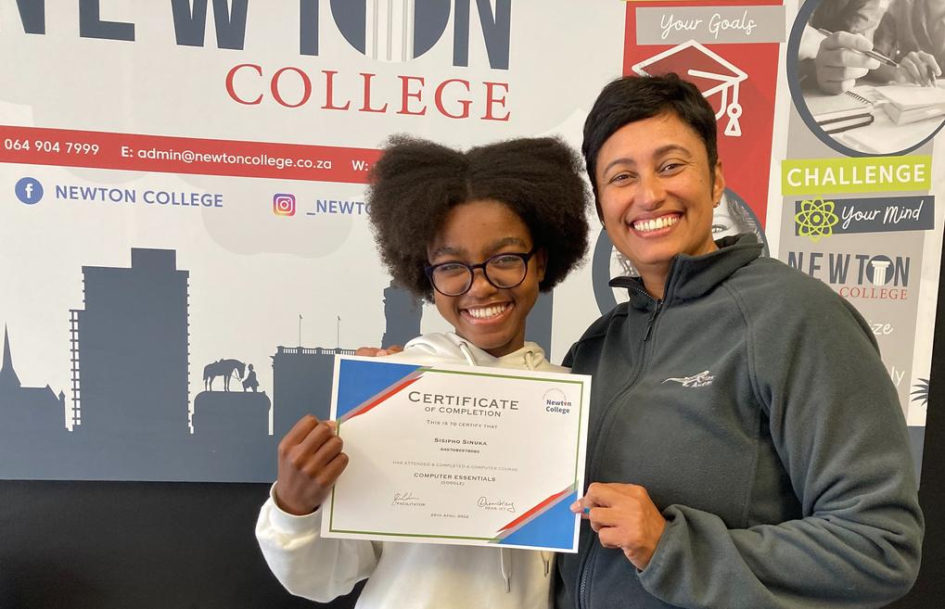
Benefits of being a Sponsor
  Increased Brand Awareness and Exposure
    social media coverage of sponsor on our website
    promote sponsor details at specific events
2. Promote company image through CSR initiatives
    Increased community awareness of brand
    Potential increased customer leads
3. Tax Benefits
    Sponsors will receive section 18(a) letters that businesses can use as a tax deduction

Slide 17

Gender-based violence programme
Newton College Foundation and Yokhuselo Haven have embarked on a collaboration to design and coordinate a GBV awareness programme.
No business entity can exist in isolation from the community in which they operate. GBV is a national epidemic and this programme is aimed at training key people within organisations to address GBV issues on within their individual companies.

